Slide 1

Lesson 2
Basic RNN,
Language modelling

Slide 2
Plan
Language model
Statistical approach
Neural approach
RNNs

Slide 3
Language model
Given sequence of words LM can predict probability of this sequence.
I have a very interesting idea. -> P(I,have,a,very,interesting,idea)

Slide 4

Where you can see it?

Slide 5
Explanation
Probability of sentence ~ how likely to see it in natural language
P(what a beautiful day) > P(a day what beautiful)

Slide 6
Language models in NLP
It is difficult to know the true probability of an arbitrary sequence of words (at least they are changing in time)
We need to approximate probability with some model
As usual this model will be better in one bunch of things and worse in another

Slide 7
Possibilities
We can do language model statistically
We can use ML algorithms

Slide 8

Statistical approach
Usually we approximate probability from sample this way:
Where N is the total number of examples.

Slide 9
Statistical approach
Can we do the same way with the whole sentence?
Unfortunately, no. Because we have not got appropriate number of examples, and also we would have to store too much data this way.
What can we do?

Slide 10

N-grams

Slide 11
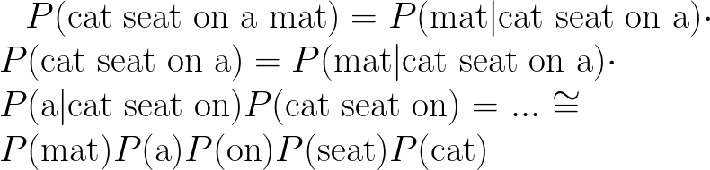
N-grams
In N-gram model we state the independence assumption: the probability of word only depends on the fixed number of previous words.
Example: unigram (1-gram)

Slide 12

N-grams
With this rule we can calculate appropriate probabilities, taking into account this:

Slide 13
Let’s go to the next solution
How can we create language model with neural networks?

Slide 14
Neural language model
Fixed size solution:
Sample probability of next token, given fixed size input:
We can concatenate word embeddings:
We still have problems with fixed size model...

Slide 15
Recurrent neural networks (RNNs)
In general, we want to have access to all previous generated text.
We want to somehow remember all information.

Slide 16
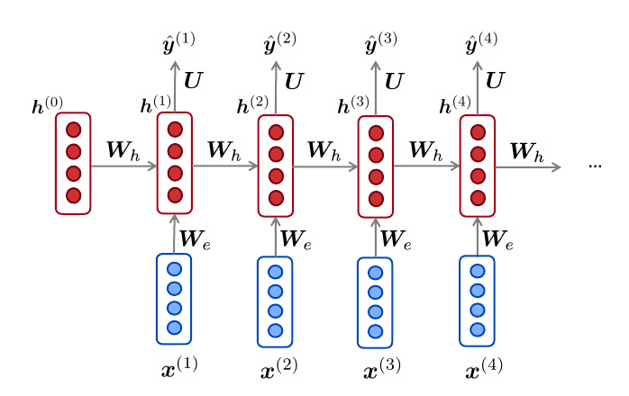
Recurrent neural networks (RNNs)

Slide 17
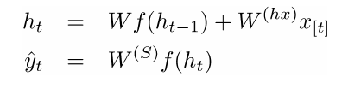
Recurrent neural networks (RNNs)

Slide 18
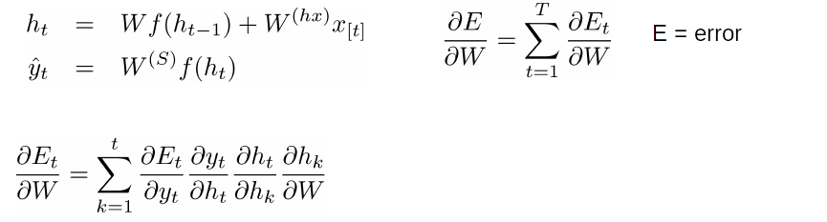
Recurrent neural networks (RNNs)

Slide 19


More chain rule

Slide 20
Recurrent neural networks (RNNs)
RNNs have a lot of benefits, but also have some problems.
Vanishing & Exploding gradients
One vector for all information

Slide 21
RNN Language model

Slide 22
RNN Language model
Benefits:
Can process any length input with the same model size
Can use information occured many steps before
Share representations
Problems:
Works quite slow
In fact it is difficult to access remote information

Slide 23

Training
Having a large amount of documents we can go through them and learn language model with cross-entropy loss word by word.

